Slide 1
19CS3113S
Analysis and Design of Algorithms
Session -21

Slide 2
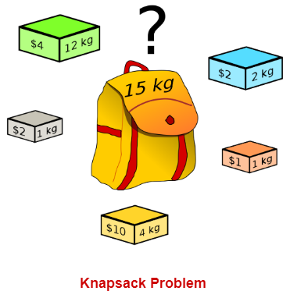
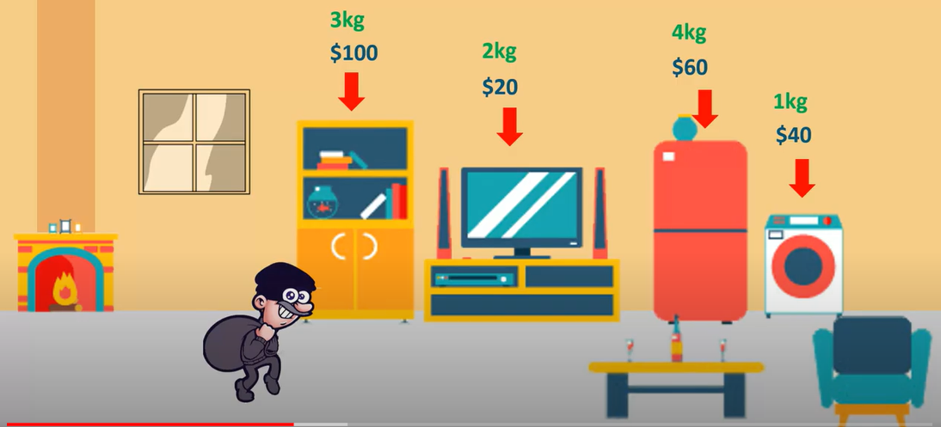
Knapsack Problem
You are given the following-
  A knapsack (kind of shoulder bag) with limited weight capacity.
  Few items each having some weight and value.
The problem states-
  Which items should be placed into the knapsack such that-
    The value or profit obtained by putting the items into the knapsack is maximum.
    And the weight limit of the knapsack does not exceed.

Slide 3

Knapsack Problem Variants & its differences
Variants:
  0/1 Knapsack.
    not allowed to break items. We either take the whole item or don’t take it.
  Fractional Knapsack
    can break items for maximizing the total value of knapsack
10kg
$10
4kg
$5
8kg
$20
7kg
$10
2kg
$3
6kg
$11
4kg
$2
8kg
$17

Slide 4
0/1 Knapsack Problem
  In 0/1 Knapsack Problem,
    As the name suggests, items are indivisible here.
    We can not take the fraction of any item.
    We have to either take an item completely or leave it completely.
  Example:
  Consider the knapsack instance n = 3, (w₁, w₂, w₃) = (2, 3, 4), (p_{1,} p_{2,} p₃) = (1, 2, 5) and m = 6.
  Probability of Chosen Items (x_{i}) = [{0, 0, 0}, {0, 0, 1}, ……, {1, 1, 1}]
  No. of Possible Solutions (2^{n}) = 2³ = 8.
  The problem is to find the Best Optimal Solution among the 8 for the 0/1 Knapsack.

Slide 5
0/1 Knapsack problem
Let f_{i}(y_{j}) be the values of optimal solution. Then S^{i} is a pair (p,w) where p = f (y_{j}) and w = y_{j}
Initially S⁰ = { (0,0) }. We can compute S^{i+1} from S^{i}. The Computations of S^{i} are sequence of decisions made for obtaining optimal solution.
2. Let x_{n} be the optimal sequence. Then there are two instances {x_{n}} and {x_{n-1},…..,x₁ }. So from {x_{n-1},…..,x₁} will choose optimal sequence with respect to x_{n}.

Slide 6
0/1 Knapsack problem
3. The formulas that are used while solving 0/1 knapsack problem.
Let f_{n}(m) be the value of an optimal solution, then
f_{n}(m)= max { f_{n-1}(m), f_{n-1}( m - w_{n}) + p_{n} }
General formula
f_{i}(y)= max { f_{i-1}(y), f_{i-1}( y - w_{i}) + p_{i} }

Slide 7
0/1 Knapsack Problem – Solution
  Consider the knapsack instance n = 3, (w₁, w₂, w₃) = (2, 3, 4), (p_{1,} p_{2,} p₃) = (1, 2, 5) and m = 6.
f_{n}(m)= max { f_{n-1}(m), f_{n-1}( m - w_{n}) + p_{n} }
f₃(6)= max { f₂(6), f₂( 6 – w₃) + p₃ }
f₃(6)= max { f₂(6), f₂( 6 – 4) + 5 }
f₃(6)= max { f₂(6), f₂( 2) + 5 }

Slide 8
0/1 Knapsack Problem – Solution
  Consider the knapsack instance n = 3, m=6
  (w₁, w₂, w₃) = (2, 3, 4) & (p_{1,} p_{2,} p₃) = (1, 2, 5).
f₃(6)= max { f₂(6), f₂( 2) + 5 }
f₂(6)= max { f₁(6), f₁( 6-3) + 2 }
f₂(6)= max { f₁(6), f₁( 3) + 2 }
f₂(2)= max { f₁(2), f₁( 2-3) + 2 }
f₂(2)= max { f₁(2), f₁( -1) + 2 }

Slide 9
0/1 Knapsack Problem – Solution
  Consider the knapsack instance n = 3, m=6
  (w₁, w₂, w₃) = (2, 3, 4) & (p_{1,} p_{2,} p₃) = (1, 2, 5).
f₃(6)= max { f₂(6), f₂( 2) + 5 }
f₂(6)= max { f₁(6), f₁( 3) + 2 }
f₂(2)= max { f₁(2), f₁( -1) + 2 }
f₁(6)= max { f₀(6), f₀( 6-2) + 1 }
f₁(6)= max { f₀(6), f₀( 4) + 1 }
f₁(6)= max { 0, 0 + 1 } = 1
f₁(3)= max { f₀(3), f₀( 3-2) + 1 }
f₁(3)= max { f₀(3), f₀( 1) + 1 }
f₁(3)= max { 0, 0 + 1 } = 1

Slide 10
0/1 Knapsack Problem – Solution
  Consider the knapsack instance n = 3, m=6
  (w₁, w₂, w₃) = (2, 3, 4) & (p_{1,} p_{2,} p₃) = (1, 2, 5).
f₃(6)= max { f₂(6), f₂( 2) + 5 }
f₂(6)= max { 1, 1 + 2 }
f₂(2)= max { f₁(2), f₁( -1) + 2 }
f₁(6)= max { f₀(6), f₀( 6-2) + 1 }
f₁(6)= max { f₀(6), f₀( 4) + 1 }
f₁(6)= max { 0, 0 + 1 } = 1
f₁(3)= max { f₀(3), f₀( 3-2) + 1 }
f₁(3)= max { f₀(3), f₀( 1) + 1 }
f₁(3)= max { 0, 0 + 1 } = 1

Slide 11
0/1 Knapsack Problem – Solution
  Consider the knapsack instance n = 3, m=6
  (w₁, w₂, w₃) = (2, 3, 4) & (p_{1,} p_{2,} p₃) = (1, 2, 5).
f₃(6)= max { f₂(6), f₂( 2) + 5 }
f₂(6)= max { 1, 3 } = 3
f₂(2)= max { f₁(2), f₁( -1) + 2 }

Slide 12
0/1 Knapsack Problem – Solution
  Consider the knapsack instance n = 3, m=6
  (w₁, w₂, w₃) = (2, 3, 4) & (p_{1,} p_{2,} p₃) = (1, 2, 5).
f₃(6)= max { f₂(6), f₂( 2) + 5 }
f₂(6)= max { 1, 1 + 2 }
f₂(2)= max { f₁(2), f₁( -1) + 2 }
f₁(2)= max { f₀(2), f₀( 2-2) + 1 }
f₁(2)= max { 0, 0 + 1 } = 1
f₁( -1)
-INF

Slide 13
0/1 Knapsack Problem – Solution
  Consider the knapsack instance n = 3, m=6
  (w₁, w₂, w₃) = (2, 3, 4) & (p_{1,} p_{2,} p₃) = (1, 2, 5).
f₃(6)= max { f₂(6), f₂( 2) + 5 }
f₂(6)= max { 1, 1 + 2 }
f₂(2)= max { 1, -INF + 2 }
f₁(2)= max { f₀(2), f₀( 2-2) + 1 }
f₁(2)= max { 0, 0 + 1 } = 1
f₁( -1)
-INF

Slide 14
0/1 Knapsack Problem – Solution
  Consider the knapsack instance n = 3, m=6
  (w₁, w₂, w₃) = (2, 3, 4) & (p_{1,} p_{2,} p₃) = (1, 2, 5).
f₃(6)= max { f₂(6), f₂( 2) + 5 }
f₂(6)= max { 1, 1 + 2 }
f₂(2)= max { 1, -INF + 2 }

Slide 15
0/1 Knapsack Problem – Solution
  Consider the knapsack instance n = 3, m=6
  (w₁, w₂, w₃) = (2, 3, 4) & (p_{1,} p_{2,} p₃) = (1, 2, 5).
f₃(6)= max { f₂(6), f₂( 2) + 5 }
f₂(6)= max { 1, 3 } = 3
f₂(2)= max { 1, -INF} = 1

Slide 16
0/1 Knapsack Problem – Solution
  Consider the knapsack instance n = 3, m=6
  (w₁, w₂, w₃) = (2, 3, 4) & (p_{1,} p_{2,} p₃) = (1, 2, 5).
f₃(6)= max { 3, 1 + 5 }
f₂(6)= max { 1, 3 } = 3
f₂(2)= max { 1, -INF} = 1

Slide 17
0/1 Knapsack Problem – Solution
  Consider the knapsack instance n = 3, m=6
  (w₁, w₂, w₃) = (2, 3, 4) & (p_{1,} p_{2,} p₃) = (1, 2, 5).
f₃(6)= max { 3, 1 + 5 } = 6

Slide 18
0/1 Knapsack Problem – Solution: Set Method
Initially S⁰ = {(0,0)}
S₁^{i} ={ ( P,W) / (P- p_{i+1},W- w_{i+1}) ϵ S^{i} }
S^{i+1} can be computed by merging from S^{i} and S₁^{i}
Purging or dominance rule: if S^{i+1} contains two pairs (p_{j}, w_{j} ) and (p_{k}, w_{k} ) with the property that p_{j} ≤ p_{k} and w_{j} ≥ w_{k} then the pair (p_{j}, w_{j} ) can be discarded.
When generating S^{i}, we can also purge all pairs ( p, w ) with w > m as these pairs determine the value of f _{n} (x) only for x > m.
The optimal solution f _{n} (m) is given by the highest profit pair.

Slide 19
0/1 Knapsack Problem – Solution: Set Method
  Consider the knapsack instance n = 3, m=6 (w₁, w₂, w₃) = (2, 3, 4) & (p_{1,} p_{2,} p₃) = (1, 2, 5).
Initially S⁰ = {(0,0)}
S₁^{i} ={ ( P,W) / (P- p_{i+1},W- w_{i+1}) ϵ S^{i} }
S^{i+1} can be computed by merging from S^{i} and S₁^{i}

Slide 20
0/1 Knapsack Problem – Solution: Set Method
  Consider the knapsack instance n = 3, m=6 (w₁, w₂, w₃) = (2, 3, 4) & (p_{1,} p_{2,} p₃) = (1, 2, 5).
S⁰ = {(0,0)} S₁⁰ ={ ( 1, 2) }
S¹ = {(0, 0), (1, 2)} S₁¹ ={ (2, 3), ( 3, 5) }
S² = {(0, 0), (1, 2), (2, 3), ( 3, 5) } S₁² ={ (5, 4), ( 6, 6), (7, 7), (8, 9) }
S³ = {(0, 0), (1, 2), (2, 3), ( 3, 5), (5, 4), ( 6, 6), (7, 7), (8, 9) }
S₁^{i} ={ ( P,W) / (P- p_{i+1},W- w_{i+1}) ϵ S^{i} }

Slide 21
0/1 Knapsack Problem – Solution: Set Method
  Consider the knapsack instance n = 3, m=6 (w₁, w₂, w₃) = (2, 3, 4) & (p_{1,} p_{2,} p₃) = (1, 2, 5).
S⁰ = {(0,0)} S₁⁰ ={ ( 1, 2) }
S¹ = {(0, 0), (1, 2)} S₁¹ ={ (2, 3), ( 3, 5) }
S² = {(0, 0), (1, 2), (2, 3), ( 3, 5) } S₁² ={ (5, 4), ( 6, 6), (7, 7), (8, 9) }
S³ = {(0, 0), (1, 2), (2, 3), ( 3, 5), (5, 4), ( 6, 6)}
S₁^{i} ={ ( P,W) / (P- p_{i+1},W- w_{i+1}) ϵ S^{i} }
S^{i+1} can be computed by merging from S^{i} and S₁^{i}

Slide 22
0/1 Knapsack Problem – Solution: Set Method
  Consider the knapsack instance n = 3, m=6 (w₁, w₂, w₃) = (2, 3, 4) & (p_{1,} p_{2,} p₃) = (1, 2, 5).
S⁰ = {(0,0)} S₁⁰ ={ ( 1, 2) }
S¹ = {(0, 0), (1, 2)} S₁¹ ={ (2, 3), ( 3, 5) }
S² = {(0, 0), (1, 2), (2, 3), ( 3, 5) } S₁² ={ (5, 4), ( 6, 6), (7, 7), (8, 9) }
S³ = {(0, 0), (1, 2), (2, 3), (5, 4), ( 6, 6)}
S₁^{i} ={ ( P,W) / (P- p_{i+1},W- w_{i+1}) ϵ S^{i} }
S^{i+1} can be computed by merging from S^{i} and S₁^{i}

Slide 23
0/1 Knapsack Problem – Solution: Set Method
  Consider the knapsack instance n = 3, m=6 (w₁, w₂, w₃) = (2, 3, 4) & (p_{1,} p_{2,} p₃) = (1, 2, 5).
S⁰ = {(0,0)} S₁⁰ ={ ( 1, 2) }
S¹ = {(0, 0), (1, 2)} S₁¹ ={ (2, 3), ( 3, 5) }
S² = {(0, 0), (1, 2), (2, 3), ( 3, 5) } S₁² ={ (5, 4), ( 6, 6), (7, 7), (8, 9) }
S³ = {(0, 0), (1, 2), (2, 3), (5, 4), ( 6, 6)}
S₁^{i} ={ ( P,W) / (P- p_{i+1},W- w_{i+1}) ϵ S^{i} }
S^{i+1} can be computed by merging from S^{i} and S₁^{i}

Slide 24
Example 1: Consider the knapsack instance n = 3,
(w₁,w₂,w₃) = (2,3,4), (p₁,p₂,p₃) = (1,2,5), and m = 6.
Initially
S⁰ = {(0,0)}
Include 1st object
S₁⁰ ={ ( 0+1,0+2) }= { (1,2) }
Next Stage can be obtained S⁰⁺¹ (S¹ )can be computed by merging from S⁰ and S₁⁰
S¹ ={(0,0)(1,2)}
Include 2nd object
S₁¹ ={ ( 0+2,0+3) (1+2, 2+3) }= { (2,3) (3,5) }
Next Stage can be obtained S¹⁺¹ (S² )can be computed by merging from S¹ and S₁¹
S² ={(0,0)(1,2)(2,3)(3,5)}
Include 3rd object
S₁² ={ ( 0+5,0+4) (1+5, 2+4)(2+5,3+4) (3+5,5+4) }
= {(5,4)(6,6)(7,7)(8,9)}

Slide 25
Next Stage can be obtained S²⁺¹ (S³ )can be computed by merging from S² and S₁²
S³ ={(0,0)(1,2)(2,3)(3,5) (5,4)(6,6)(7,7)(8,9)}
Apply Purging rule
Pairs(3,5) (7,7)(8,9) will be discarded
Therefore ,
S³ ={(0,0)(1,2)(2,3)(5,4)(6,6)}
X=(1,0,1)

Slide 26
0/1 Knapsack Algorithm
Algorithm DKP(p,w,n,m)
{
S⁰ := {(0,0)};
for i := 1 to n-1 do
{
S^{i-1} ={(P,W)|(P-p_{i} ,W-w_{i} ) ϵ S^{i-1} and W <= m);
S^{i} = MergePurge(S^{i-1} , S₁^{i-1});
}

Slide 27
(PX,WX) = last pair in S^{n-1} ;
(PY,WY)=(P¹+ p_{n} ,W¹+w_{n} ) where W¹ is the largest W in any pair in S^{n-1} such that W+ w_{n} <= m;
// Trace back for x_{n} ,x_{n-1},…..,x_{1.}
if (PX > PY) then x_{n} = 0;
else x_{n}=1;
TraceBackFor(x_{n-1},…..,x₁);
}

Slide 28
Complexity Analysis
The complexity of the 0/1 knapsack algorithm
The complexity of the algorithm is O(n²).

Slide 29
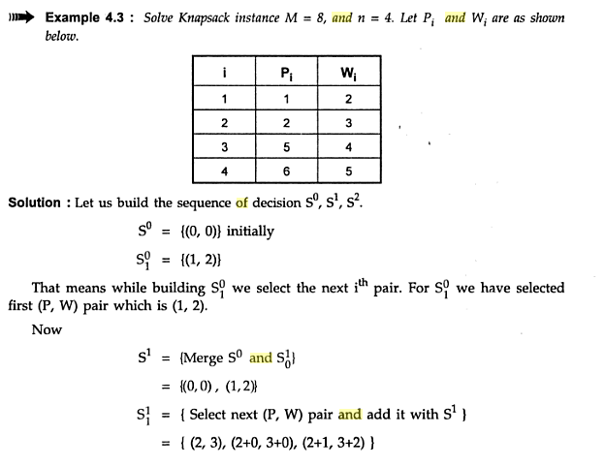

Slide 30
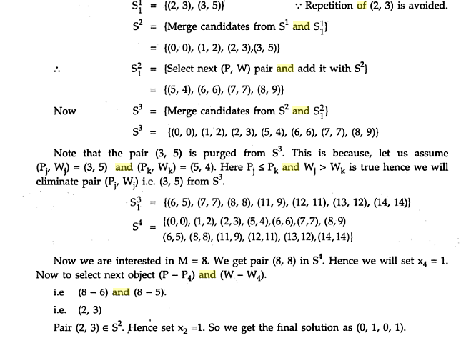

Slide 31
  Consider the knapsack instance n = 3, m=50, (w₁, w₂, w₃) = (10,20,30) & (p_{1,} p_{2,} p₃) = (60, 100, 120).

Slide 32
Thank You

